Slide 1
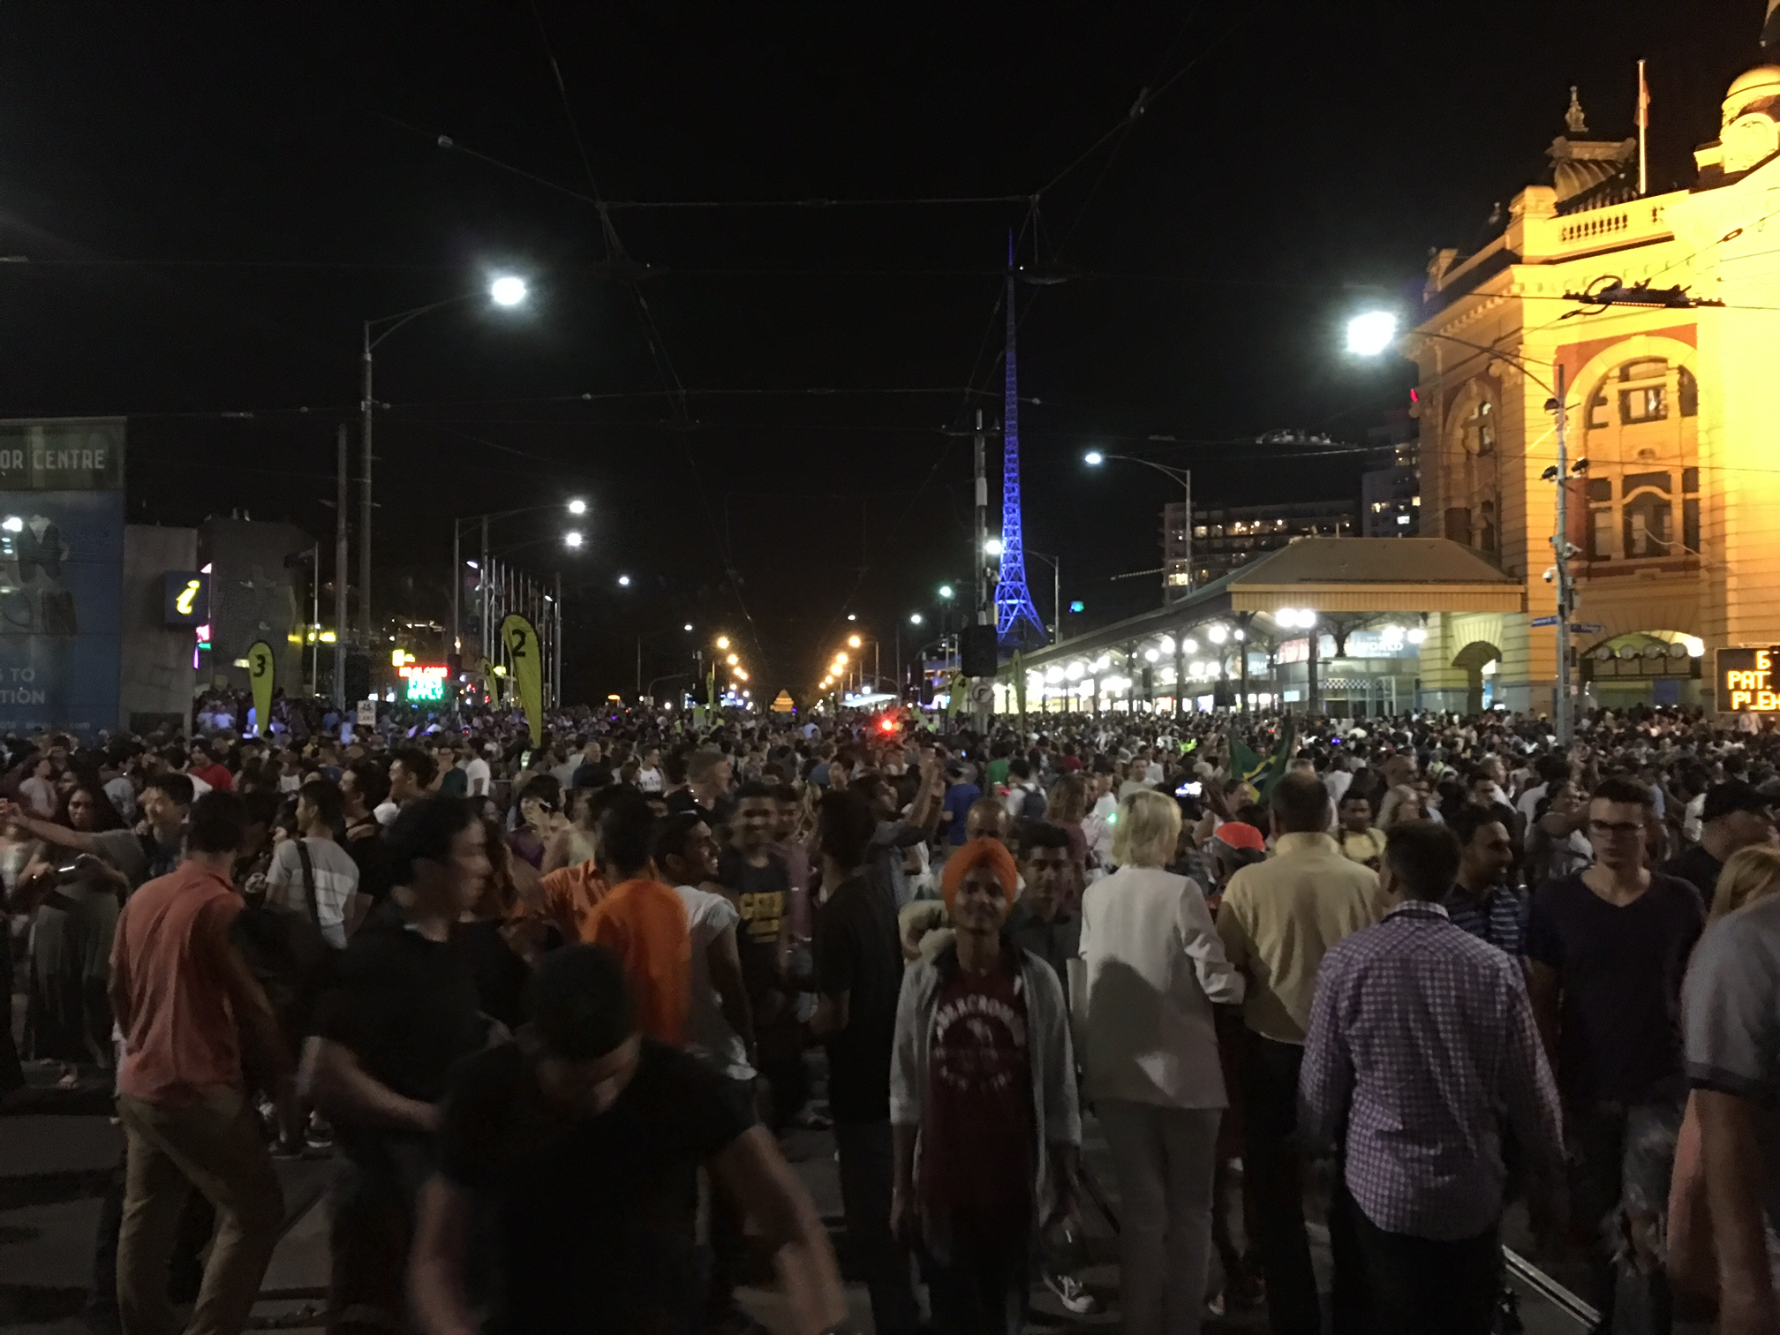

Slide 2
“…the king was attracted to Esther more than to any of the other women, and she won his favor and approval more than any of the other virgins. So he set a royal crown on her head and made her queen instead of Vashti.” (Esther 2:17)

Slide 3
For if you remain silent at this time, relief and deliverance for the Jews will arise from another place, but you and your father’s family will perish. And who knows but that you have come to your royal position for such a time as this?” (Esther 4:13-14)

Slide 4
“Go, gather together all the Jews who are in Susa, and fast for me. Do not eat or drink for three days, night or day. I and my attendants will fast as you do. When this is done, I will go to the king, even though it is against the law. And if I perish, I perish.” (Esther 4:16)

Slide 5
“Mordecai the Jew was second in rank to King Xerxes, preeminent among the Jews, and held in high esteem by his many fellow Jews, because he worked for the good of his people and spoke up for the welfare of all the Jews.” (Esther 10:3)

Slide 6
DISCIPLESHIP

Slide 7
CONNECT

Slide 8
CARE

Slide 9
EVANGELISM

Slide 10
COMMUNITY ENGAGEMENT

Slide 11
OUR VISION…
To be a community of empowered believers reaching our city, state, nation and globe for Christ.
“Come, follow me,” Jesus said, “and I will make you fishers of men.” (Matthew 4:19 NIV)

Slide 12
OUR MISSION…
To develop people into fully devoted followers of Jesus Christ.
“Therefore go and make disciples of all nations, baptising them in the name of the Father and of the Son and of the Holy Spirit and teaching them to obey everything I have commanded you…”
(Matthew 28:19-20 NIV)

Slide 13
OUR MINISTRY STRATEGY…
We are committed to the task of making disciples (i.e. followers of Jesus Christ) using the strategy of relational environments.

Slide 14
BY FAITH, WE IMAGINE BY 2020 THAT OUR CHURCH WILL…

Slide 15
1. Be widely known as a disciple-making church where a growing number of people are putting Christ first in every aspect of life.

Slide 17
“To reach and disciple people we’ve never reached before means we need to do things that we’ve never done before”

Slide 18
2. Have close to 80 small groups where young and old are following Jesus, being transformed by Him and are committed to living out His mission in this world.

Slide 19
3. Expand the reach of our community engagement through Bendigo Baptist Community Care Inc. (BBCCI) and grow the Bendigo Christian College to a size of 100 students.

Slide 20
4. Have a significant intern program that is designed to nurture the growth of God’s people and serve our growing church.

Slide 21
5. Have a senior staff team of eight (full or part-time equivalent) with additional pastoral and support staff across the life of our church.

Slide 22
6. Be giving away over $250,000 each year towards mission, aid and church planting initiatives around our city, state, nation and globe.

Slide 23
7. Be working closely with other Baptist Churches to advance the Kingdom of God in this city, with the understanding that we are always better together.

Slide 24
8. Have over 2000 people in our church community, many of whom are new believers, living out the principle of being and making disciples / followers of Jesus Christ.

Slide 25
ALL THE BELIEVERS WERE UNITED IN HEART AND MIND…
ACTS 4:32

